Slide 1
Multi-Objective Least-Squares
20170517 S.J. Hahn

Slide 2
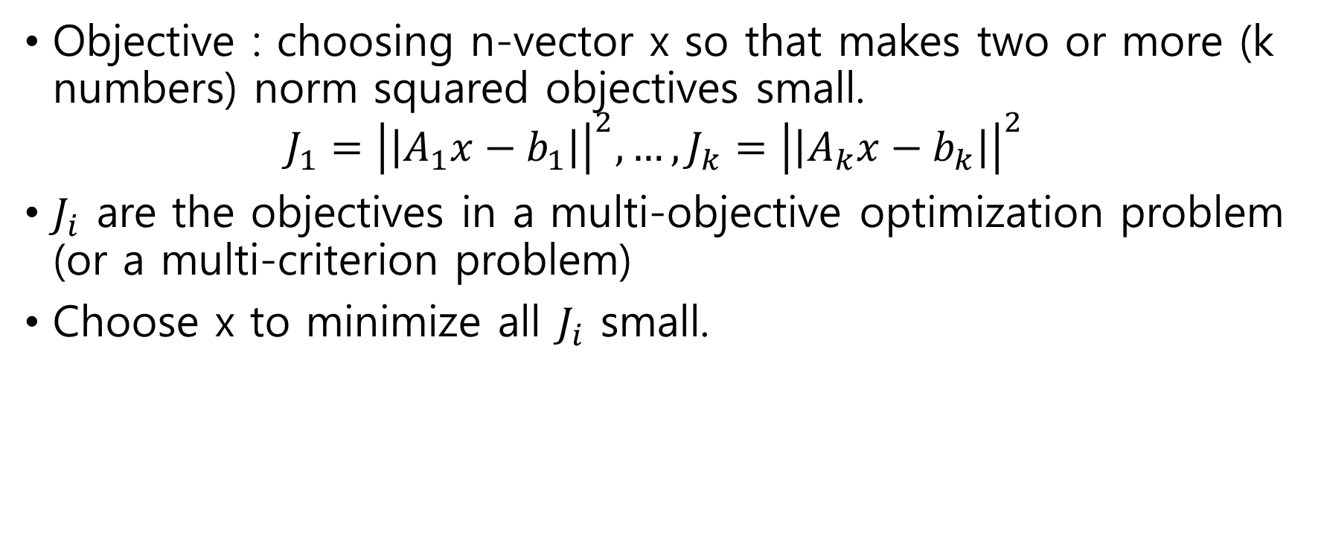
Multi-Objective Least-Squares
Objective : choosing n-vector x so that makes two or more (k numbers) norm squared objectives small.
$$J_{1}={\left|\left|A_{1}x−b_{1}\right|\right|}^{2}, …, J_{k}={\left|\left|A_{k}x−b_{k}\right|\right|}^{2}$$
$J_{i}$ are the objectives in a multi-objective optimization problem (or a multi-criterion problem)
Choose x to minimize all $J_{i}$ small.

Slide 3
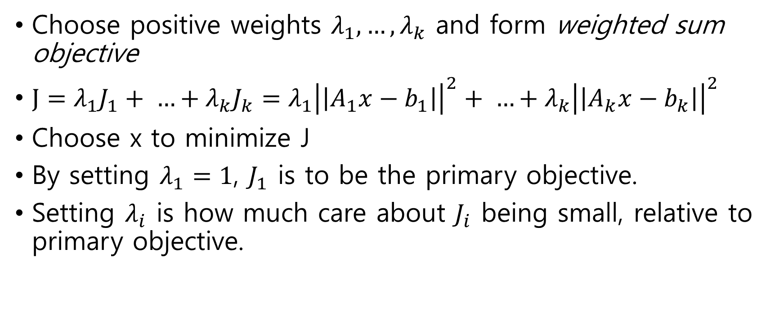
Weighted Sum Objective
Choose positive weights $λ_{1}, …,λ_{k}$ and form weighted sum objective
$J=λ_{1}J_{1}+ …+λ_{k}J_{k}=λ_{1}{\left|\left|A_{1}x−b_{1}\right|\right|}^{2}+ …+λ_{k}{\left|\left|A_{k}x−b_{k}\right|\right|}^{2}$
Choose x to minimize J
By setting $λ_{1}=1$, $J_{1}$ is to be the primary objective.
Setting $λ_{i}$ is how much care about $J_{i}$ being small, relative to primary objective.

Slide 4
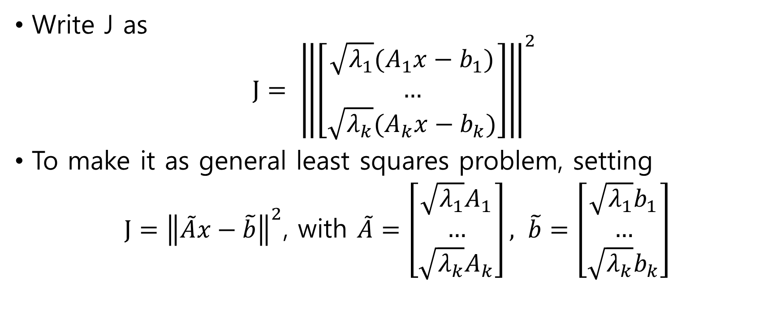
Weighted Sum Minimization via stacking
Write J as
$$J= {\left\|\left[\begin{aligned}\sqrt{λ_{1}}(A_{1}x−b_{1}) \\ … \\ \sqrt{λ_{k}}(A_{k}x−b_{k})\end{aligned}\right]\right\|}^{2}$$
To make it as general least squares problem, setting
$J={\left\|\tilde{A}x−\tilde{b}\right\|}^{2}$, with $\tilde{A}=\left[\begin{aligned}\sqrt{λ_{1}}A_{1} \\ … \\ \sqrt{λ_{k}}A_{k}\end{aligned}\right], \tilde{b}=\left[\begin{aligned}\sqrt{λ_{1}}b_{1} \\ … \\ \sqrt{λ_{k}}b_{k}\end{aligned}\right]$

Slide 5
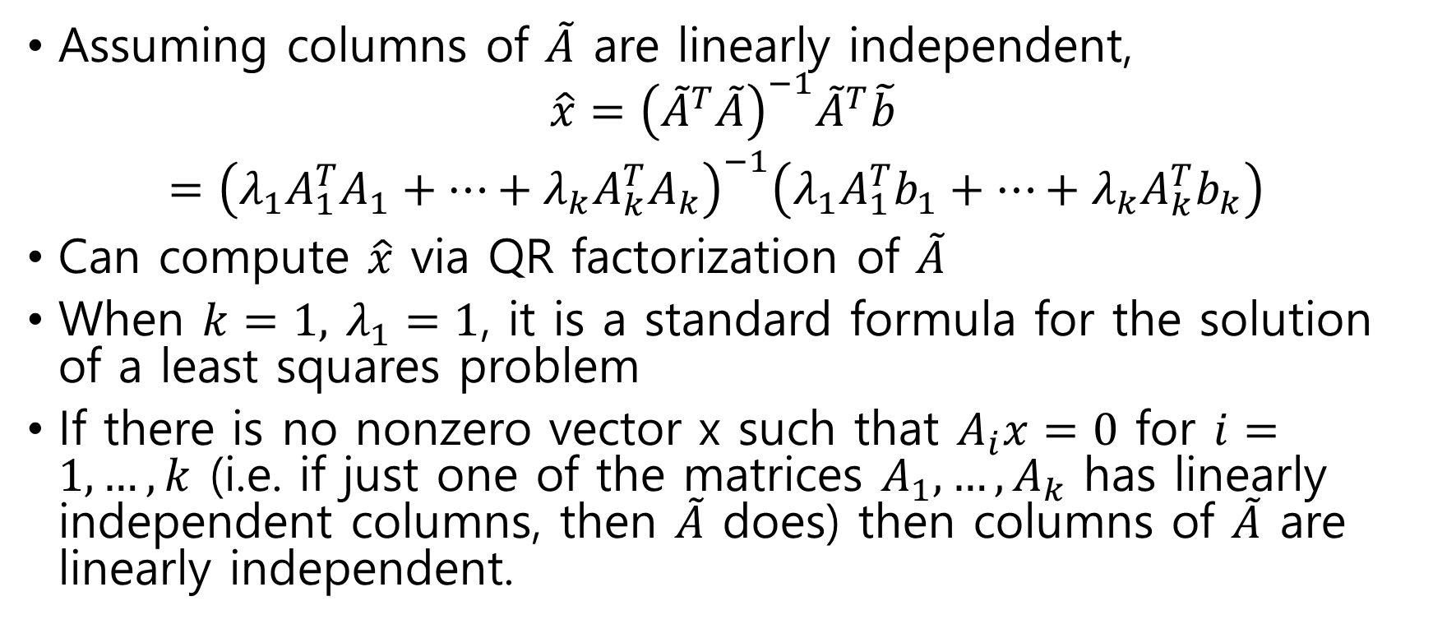
Weighted Sum Solution
Assuming columns of $\tilde{A}$ are linearly independent,
$$\hat{x}={\left({\tilde{A}}^{T}\tilde{A}\right)}^{−1}{\tilde{A}}^{T}\tilde{b}$$
$={\left(λ_{1}A_{1}^{T}A_{1}+…+λ_{k}A_{k}^{T}A_{k}\right)}^{−1}\left(λ_{1}A_{1}^{T}b_{1}+…+λ_{k}A_{k}^{T}b_{k}\right)$
Can compute $\hat{x}$ via QR factorization of $\tilde{A}$
When $k=1,$ $λ_{1}=1$, it is a standard formula for the solution of a least squares problem
If there is no nonzero vector x such that $A_{i}x=0$ for $i=1,…,k$ (i.e. if just one of the matrices $A_{1},…,A_{k}$ has linearly independent columns, then $\tilde{A}$ does) then columns of $\tilde{A}$ are linearly independent.

Slide 6
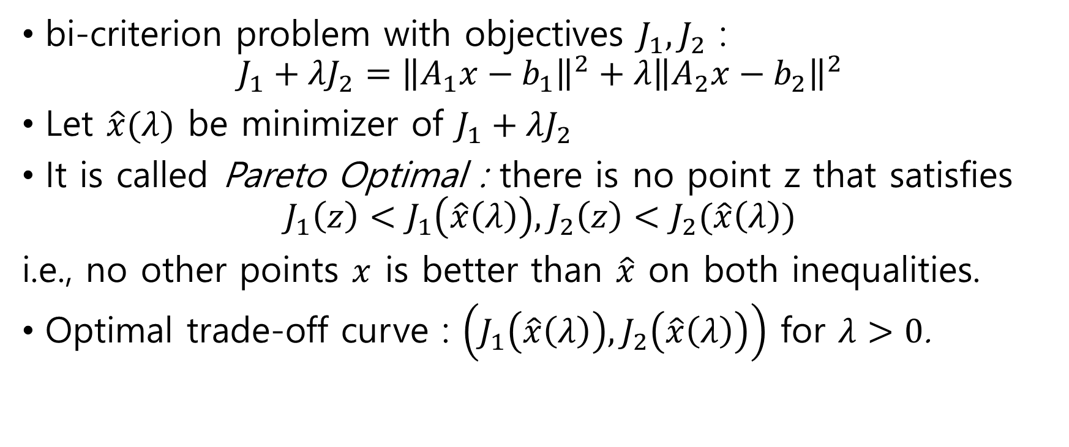
Optimal trade-off curve
bi-criterion problem with objectives $J_{1}, J_{2}$ :
$$J_{1}+λJ_{2}={\left\|A_{1}x−b_{1}\right\|}^{2}+λ{\left\|A_{2}x−b_{2}\right\|}^{2}$$
Let $\hat{x}(λ)$ be minimizer of $J_{1}+λJ_{2}$
It is called Pareto Optimal : there is no point z that satisfies $J_{1}\left(z\right)<J_{1}\left(\hat{x}\left(λ\right)\right), J_{2}\left(z\right)<J_{2}(\hat{x}\left(λ\right))$
i.e., no other points $x$ is better than $\hat{x}$ on both inequalities.
Optimal trade-off curve : $\left(J_{1}\left(\hat{x}\left(λ\right)\right),J_{2}\left(\hat{x}\left(λ\right)\right)\right)$ for $λ>0$.

Slide 7
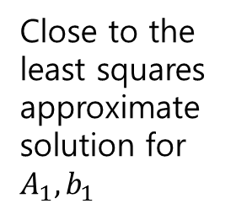
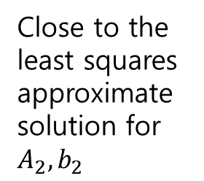
Weighted-sum least squares solution
Close to the least squares approximate solution for $A_{1}, b_{1}$
Close to the least squares approximate solution for $A_{2}, b_{2}$

Slide 8

Objective Functions versus $λ$

Slide 9
Optimal trade-off curve
Minimize
Minimize

Slide 10
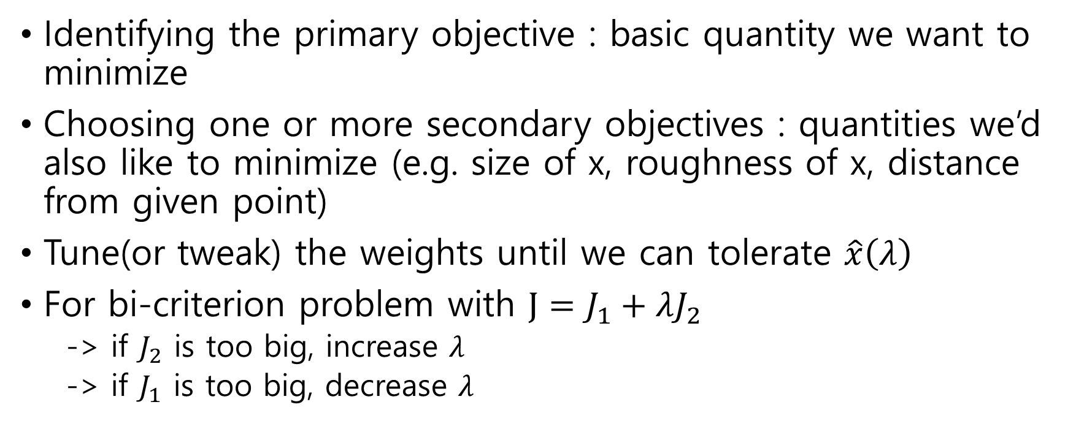
Multi-objective least-squares
Identifying the primary objective : basic quantity we want to minimize
Choosing one or more secondary objectives : quantities we’d also like to minimize (e.g. size of x, roughness of x, distance from given point)
Tune(or tweak) the weights until we can tolerate $\hat{x}\left(λ\right)$
For bi-criterion problem with $J=J_{1}+λJ_{2}$
-> if $J_{2}$ is too big, increase $λ$
-> if $J_{1}$ is too big, decrease $λ$

Slide 11
Control
Objective is to decide on a set of actions(or inputs) to optimize multiple objectives on x and y: inputs and outputs are related by an affine model
n-vector x : actions or inputs
m-vector y : results or outputs
x and y relation : y = Ax + b
A and b are known from analytical models, data fitting, …

Slide 12
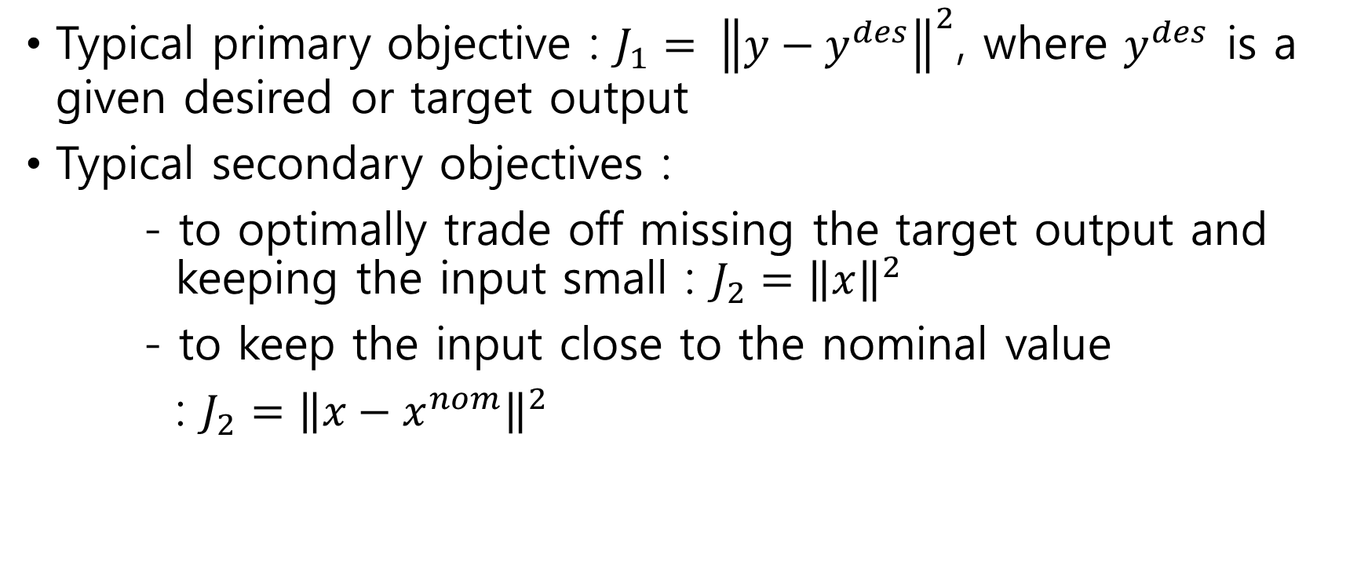
Multi-objective Control
Typical primary objective : $J_{1}= {\left\|y−y^{des}\right\|}^{2}$, where $y^{des}$ is a given desired or target output
Typical secondary objectives :
- to optimally trade off missing the target output and keeping the input small : $J_{2}={\left\|x\right\|}^{2}$
- to keep the input close to the nominal value
: $J_{2}={\left\|x−x^{nom}\right\|}^{2}$

Slide 13
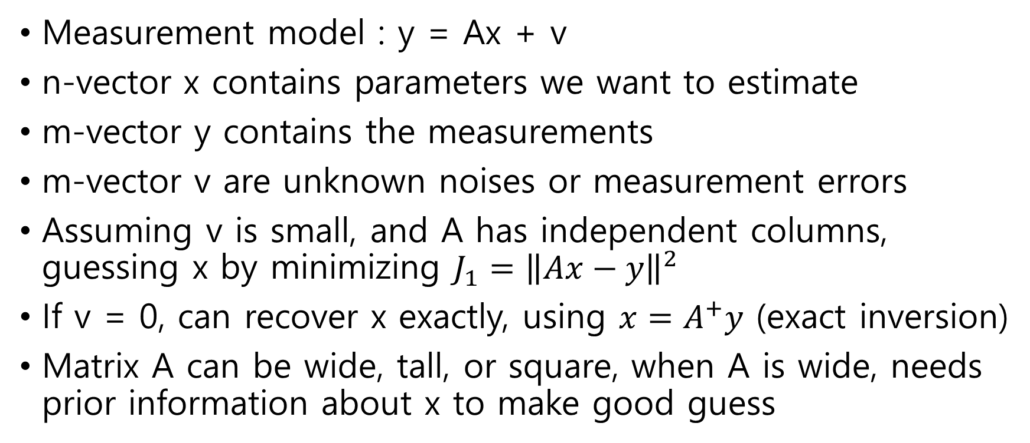
Estimation
Measurement model : y = Ax + v
n-vector x contains parameters we want to estimate
m-vector y contains the measurements
m-vector v are unknown noises or measurement errors
Assuming v is small, and A has independent columns, guessing x by minimizing $J_{1}={\left\|Ax−y\right\|}^{2}$
If v = 0, can recover x exactly, using $x=A^{+}y$ (exact inversion)
Matrix A can be wide, tall, or square, when A is wide, needs prior information about x to make good guess

Slide 14
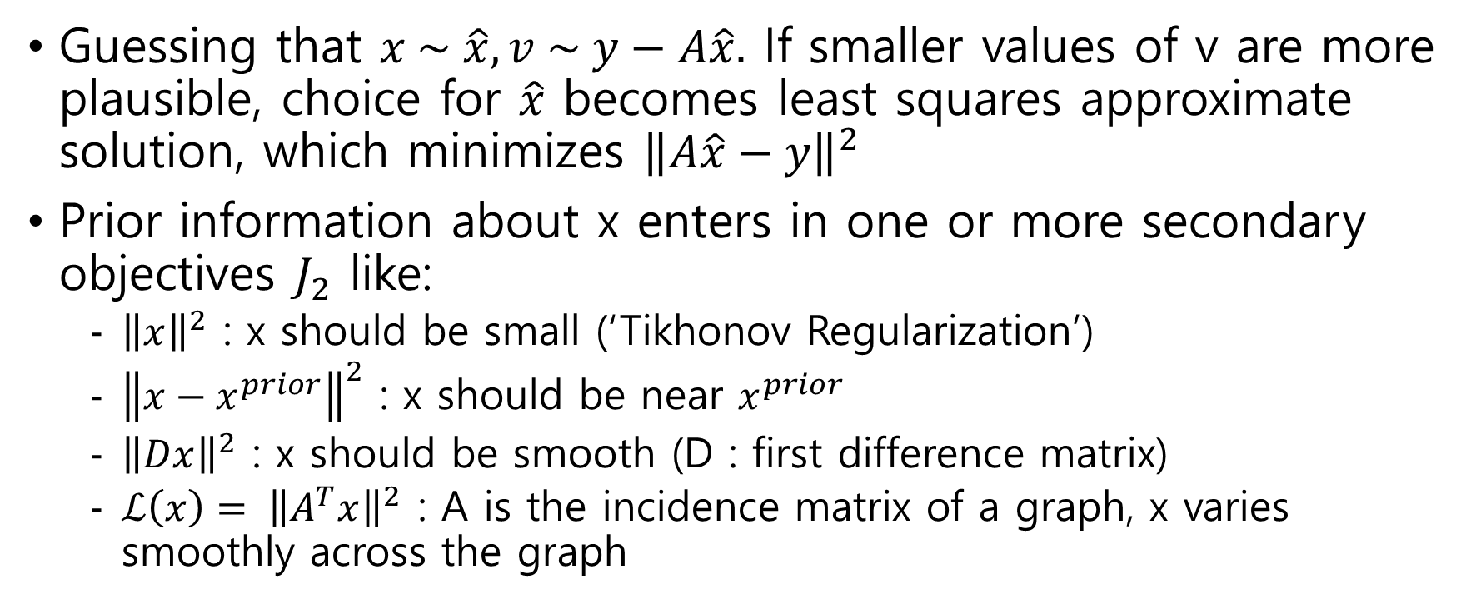
Regularized Inversion
Guessing that $x \sim \hat{x}, v \sim y−A\hat{x}.$ If smaller values of v are more plausible, choice for $\hat{x}$ becomes least squares approximate solution, which minimizes ${\left\|A\hat{x}−y\right\|}^{2}$
Prior information about x enters in one or more secondary objectives $J_{2}$ like:
${\left\|x\right\|}^{2}$ : x should be small (‘Tikhonov Regularization’)
${\left\|x−x^{prior}\right\|}^{2}$ : x should be near $x^{prior}$
${\left\|Dx\right\|}^{2}$ : x should be smooth (D : first difference matrix)
$ℒ\left(x\right)= {\left\|A^{T}x\right\|}^{2}$ : A is the incidence matrix of a graph, x varies smoothly across the graph

Slide 15

Regularized Inversion
Then, minimize $J_{1}+λJ_{2}$, adjusting $λ$ to get the optimal results
Especially for Tikhonov regularization, it works even when A has dependent columns (e.g. when it is wide)

Slide 16
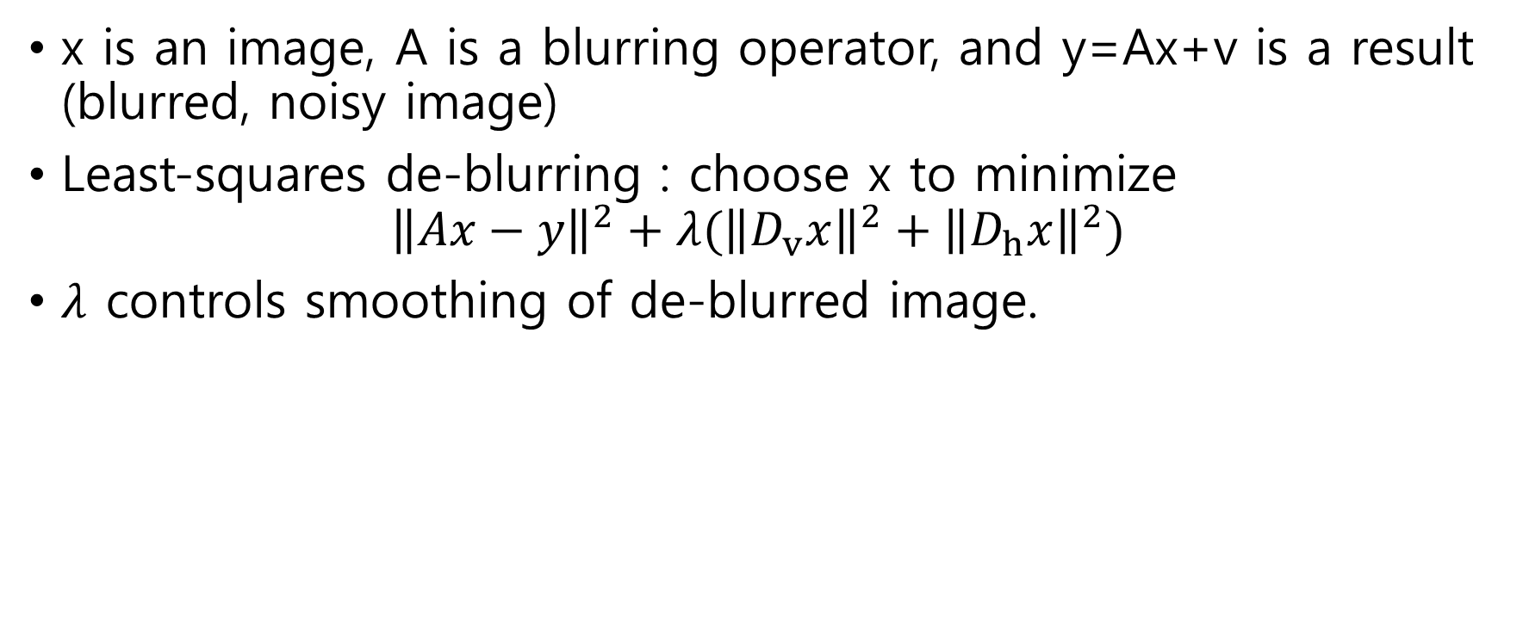
Example : image de-blurring
x is an image, A is a blurring operator, and y=Ax+v is a result (blurred, noisy image)
Least-squares de-blurring : choose x to minimize
$${\left\|Ax−y\right\|}^{2}+λ({\left\|D_{v}x\right\|}^{2}+{\left\|D_{h}x\right\|}^{2})$$
$λ$ controls smoothing of de-blurred image.

Slide 17

Example : image de-blurring
Blurred noisy image => regularized inversion with $λ=0.007$

Slide 18
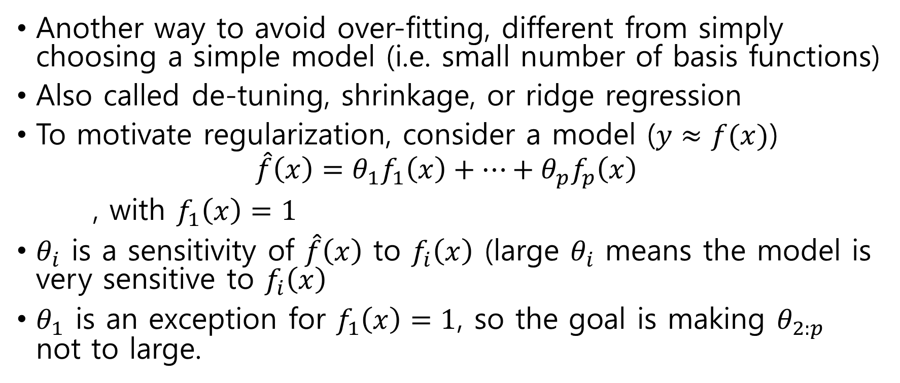
Regularized data-fitting
Another way to avoid over-fitting, different from simply choosing a simple model (i.e. small number of basis functions)
Also called de-tuning, shrinkage, or ridge regression
To motivate regularization, consider a model ($y≈f(x)$)
$$\hat{f}\left(x\right)=θ_{1}f_{1}\left(x\right)+…+θ_{p}f_{p}\left(x\right)$$
, with $f_{1}\left(x\right)=1$
$θ_{i}$ is a sensitivity of $\hat{f}\left(x\right)$ to $f_{i}\left(x\right)$ (large $θ_{i}$ means the model is very sensitive to $f_{i}\left(x\right)$
$θ_{1}$ is an exception for $f_{1}\left(x\right)=1$, so the goal is making $θ_{2:p}$ not to large.

Slide 19
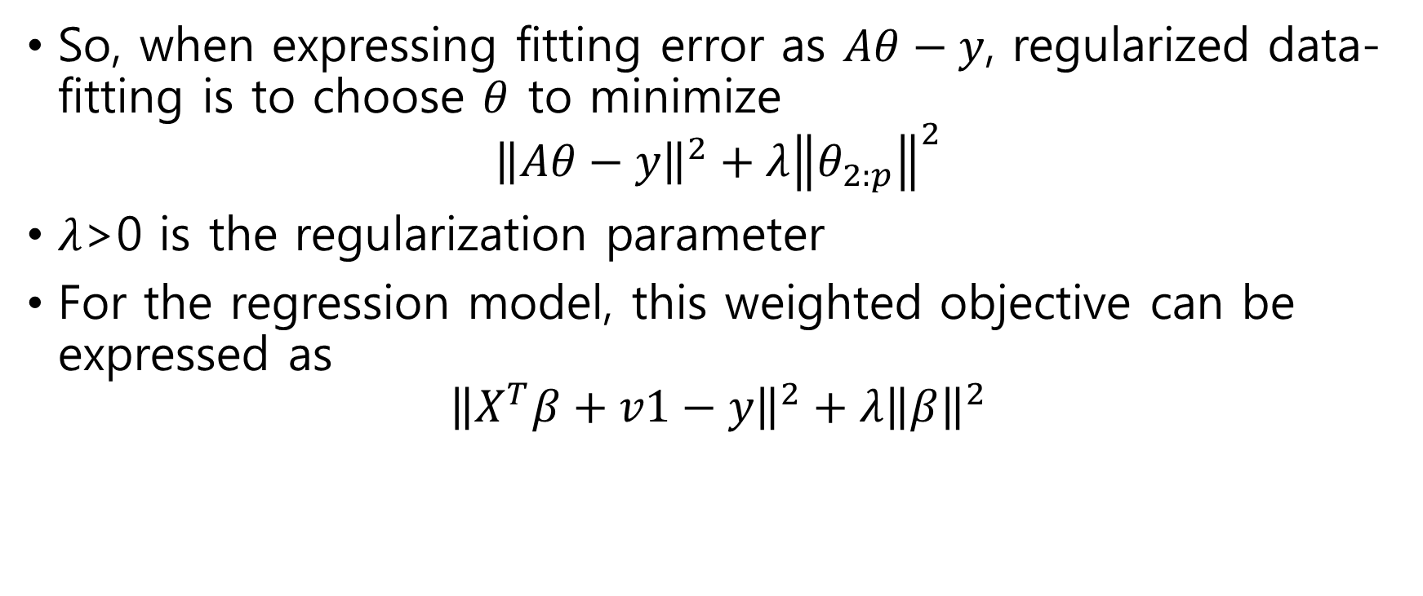
Regularized data-fitting
So, when expressing fitting error as $Aθ−y$, regularized data-fitting is to choose $θ$ to minimize
$${\left\|Aθ−y\right\|}^{2}+λ{\left\|θ_{2:p}\right\|}^{2}$$
$λ$>0 is the regularization parameter
For the regression model, this weighted objective can be expressed as
$${\left\|X^{T}β+v1−y\right\|}^{2}+λ{\left\|β\right\|}^{2}$$

